Slide 1
Link to the slides
https://tinyurl.com/geopro23

Slide 2
3D Vision Summer School 2023
Geometry Processing
Introduction to Meshlab
Astitva Srivastava
CVIT, IIITH

Slide 3
File Formats
OBJ : The OBJ file format is a simple data-format that represents 3D geometry alone — namely, the position of each vertex, the UV position of each texture coordinate vertex, vertex normals, and the faces that make each polygon defined as a list of vertices, and texture vertices. Also comes with a material file ( mtl ).
v x₁ y₁ z₁ nx₁ ny₁ nz₁
v x₂ y₂ z₂ nx₂ ny₂ nz₂
.
.
.
v x_{k} y_{k} z_{k} nx_{k} ny_{k} nz_{k}
vt u₁ v₁
vt u₂ v₂
.
.
.
vt u_{m} v_{m}
f v₀^{index} / vt₀^{index} v₁^{index} / vt₁^{index} v₂^{index} / vt₂^{index}
v₀
v₂
v₁

Slide 4
File Formats
PLY : PLY is a computer file format known as the Polygon File Format or the Stanford Triangle Format. It was principally designed to store three-dimensional data from 3D scanners. The data storage format supports a relatively simple description of a single object as a list of nominally flat polygons
Binary Encoding
Human unreadable
Most effective for storing point cloud data
Not recommended for textured meshes

Slide 5
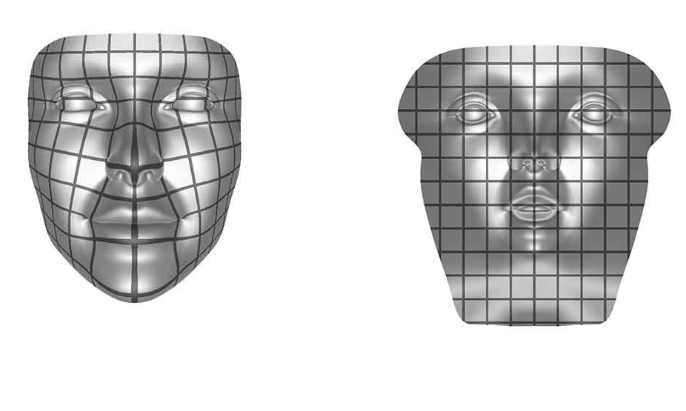
UV Parametrization

Slide 6
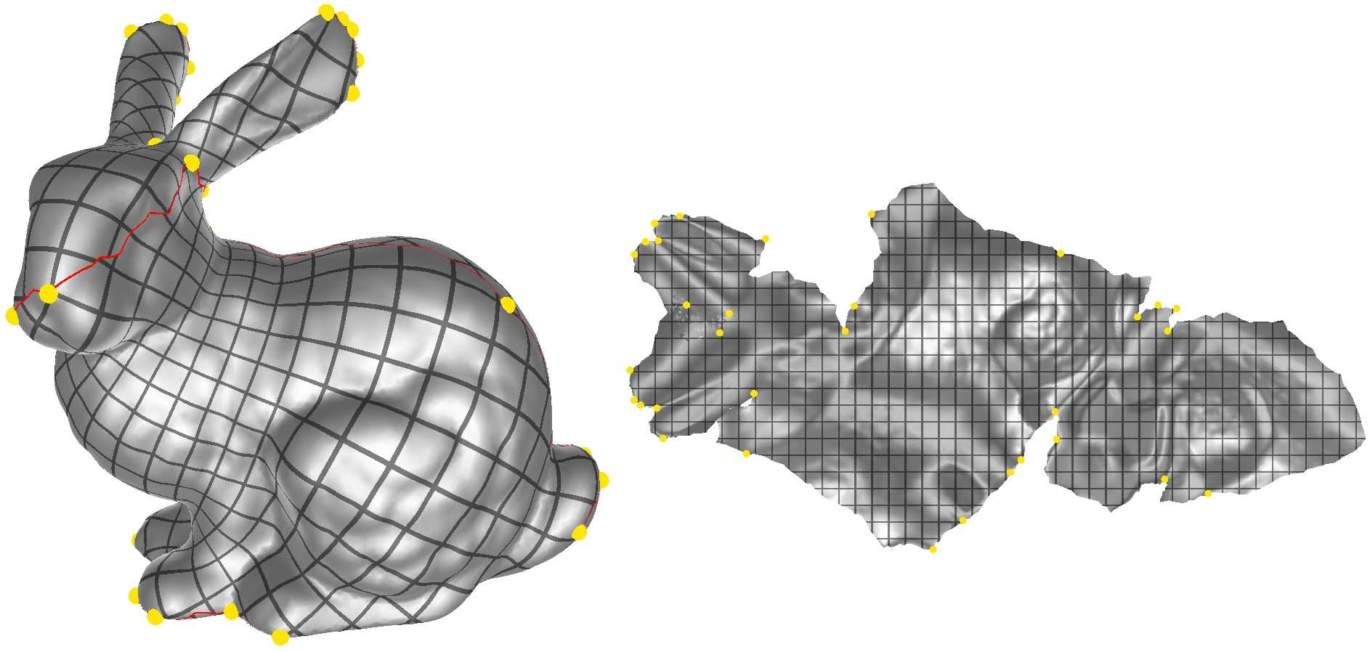
UV Parametrization

Slide 7
UV Parametrization

Slide 8
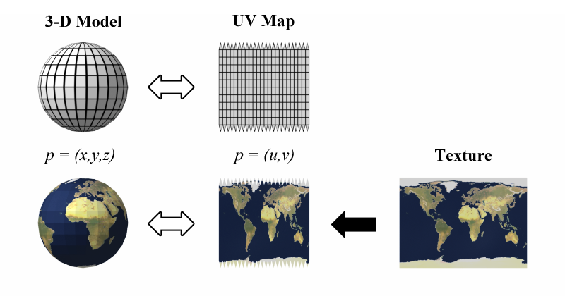
Texture Mapping

Slide 9
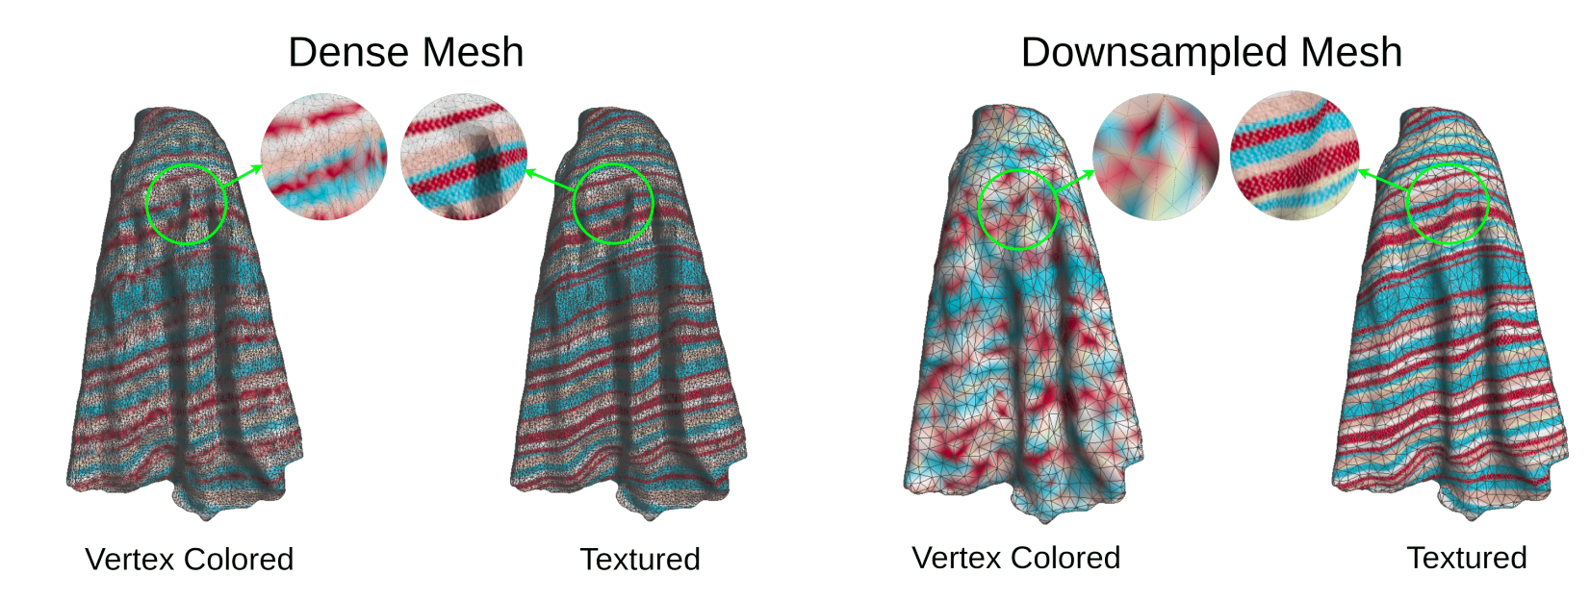
Applications of UV Mapping

Slide 10
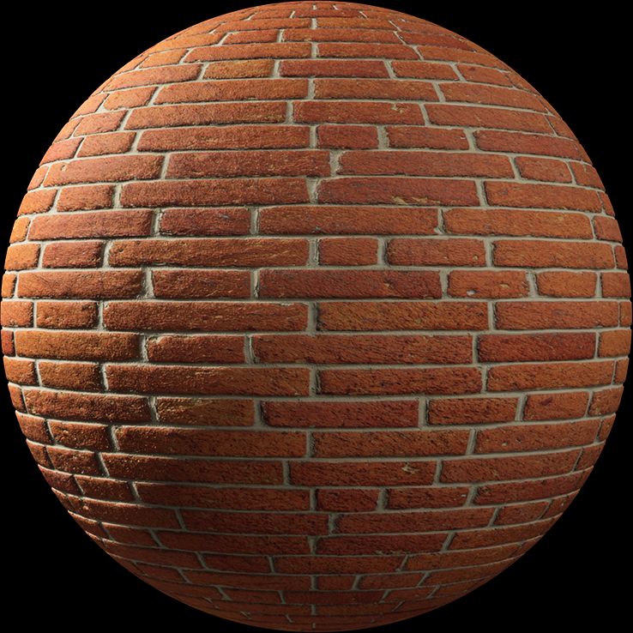
Applications of UV Mapping

Slide 11
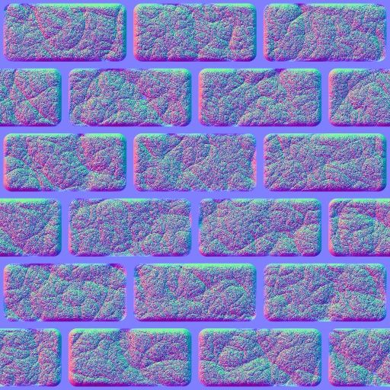
Applications of UV Mapping
Tiled Normal Map

Slide 12

Meshlab
Meshlab : The open source system for processing and editing 3D triangular meshes. It provides a set of tools for editing, cleaning, healing, inspecting, rendering, texturing and converting 3D representations.

Slide 13
Meshlab : Outline
Data: https://tinyurl.com/geoprodata23
Interface
What are Filters?
Basic operations on point clouds (Density estimation, radius estimation, cleaning)
Surface Reconstruction (Ball Pivoting, PSR)
Basic operations on meshes
Smoothening
Remeshing
Alignment/ Registration
Attribute Transfer
Parametrization & Texture Mapping

Slide 14
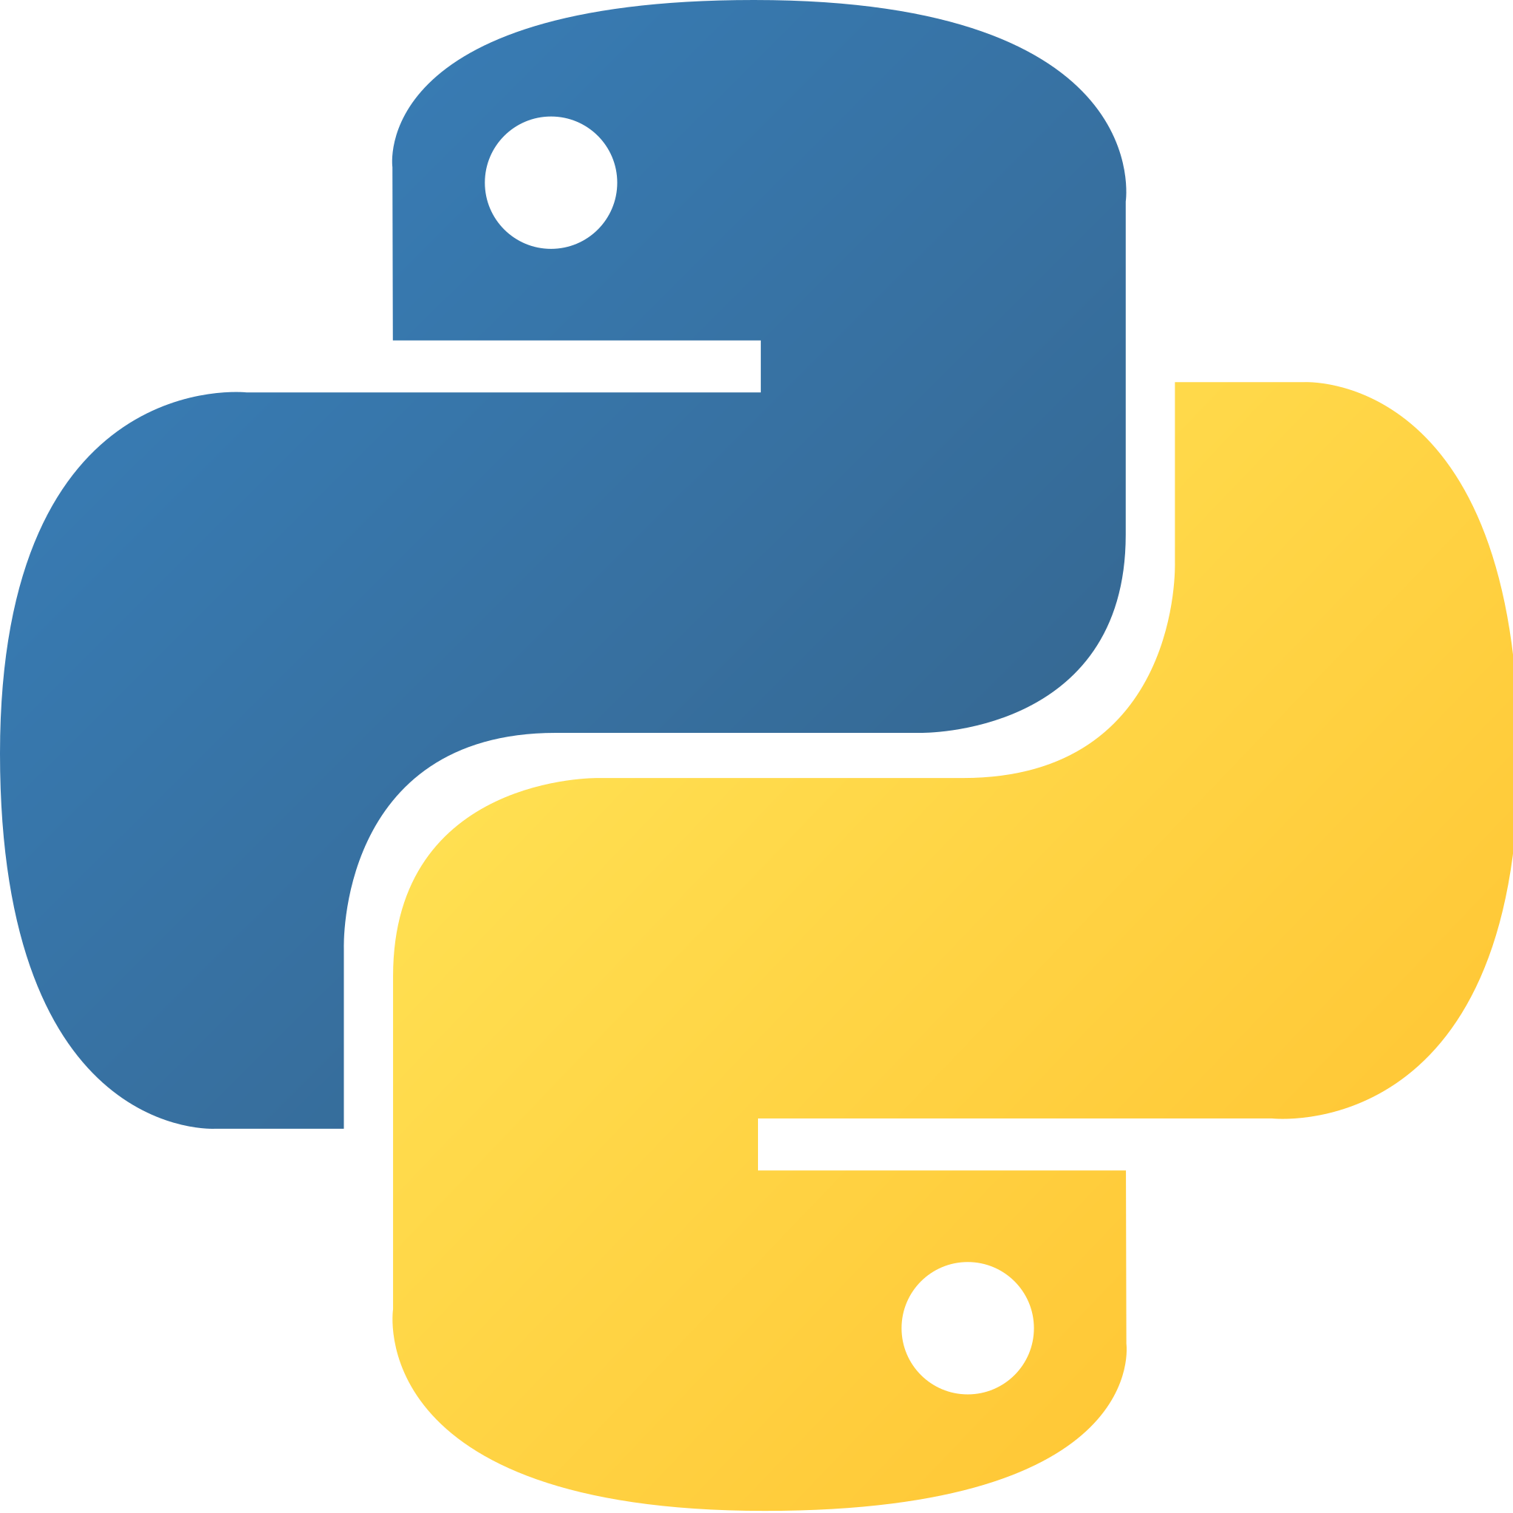
PyMeshlab
Colab : https://tinyurl.com/meshlab23

Slide 15
Summary
What have we learned ?
Major file formats for storing 3D information.
UV Parametrization
Standard Meshlab filters and how to apply them.
Applying meshlab filters in python using PyMeshlab

Slide 16
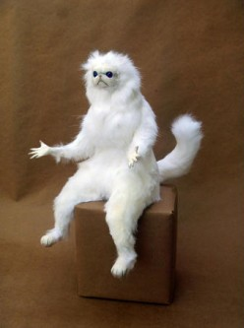
Now What?
Explore Meshlab filters — read respective papers.
Try more advanced operations in PyMeshlab, including applying filters on multiple meshes at once.

Slide 17
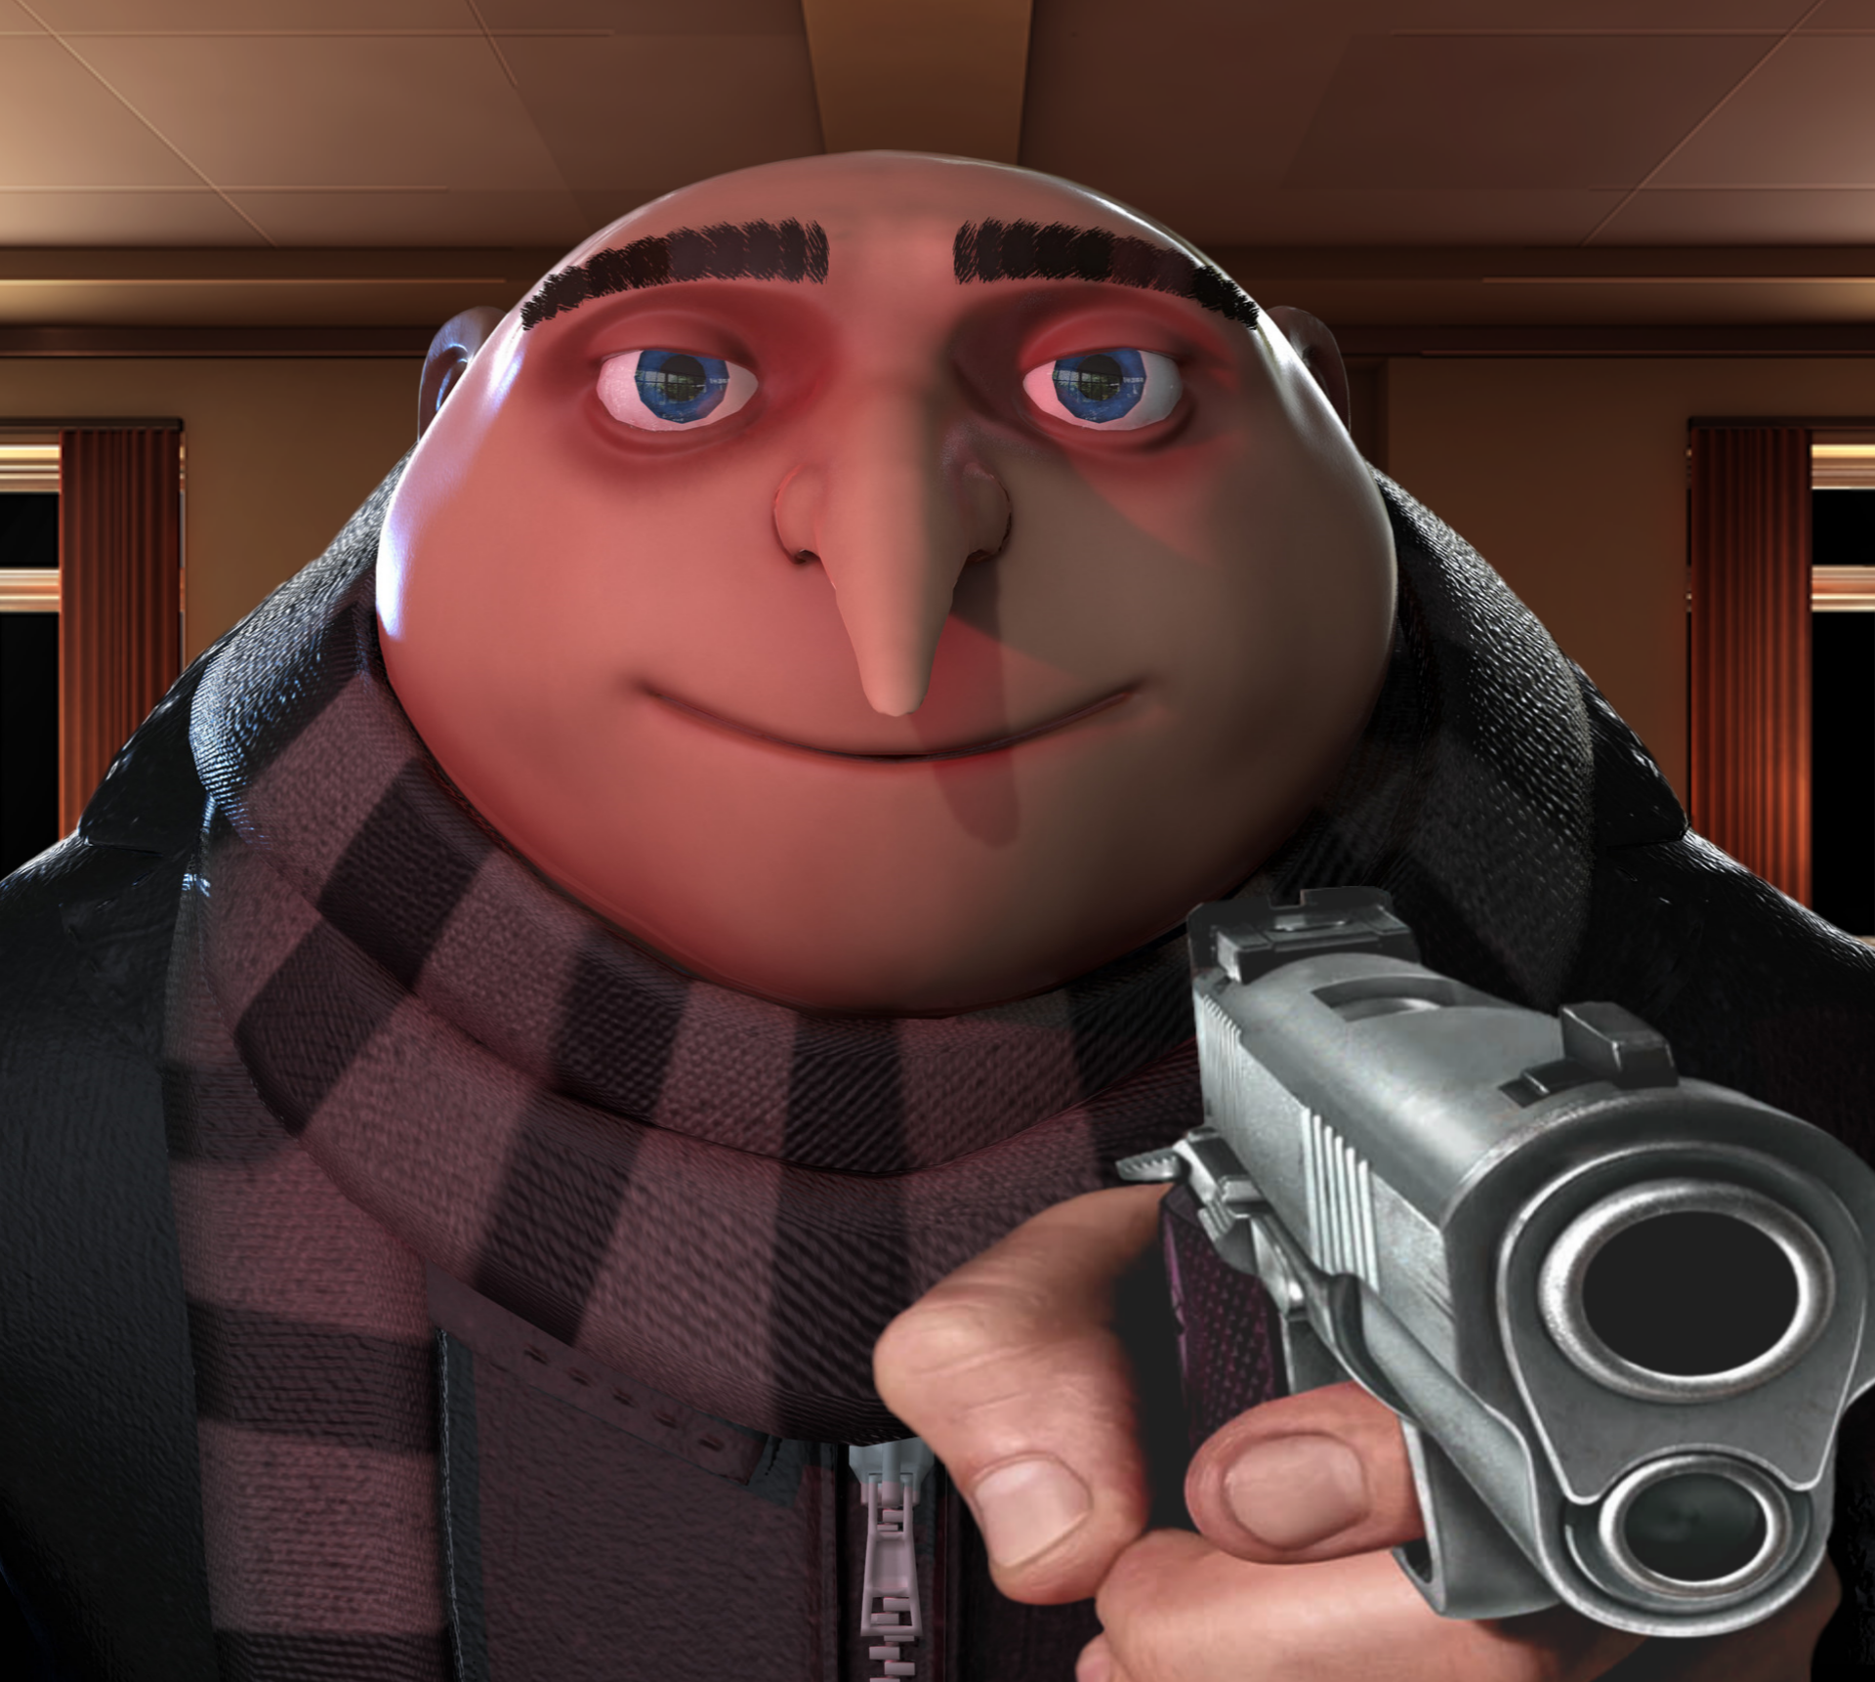
Any Questions ?

